Slide 1

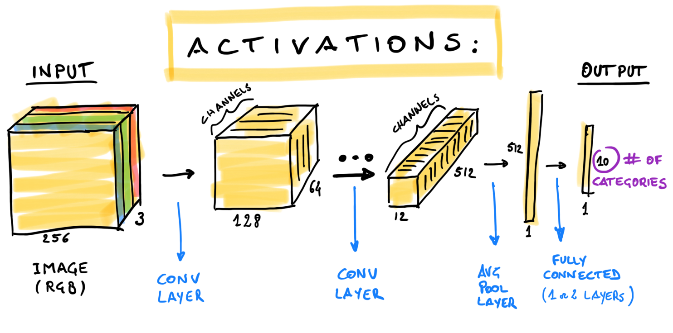
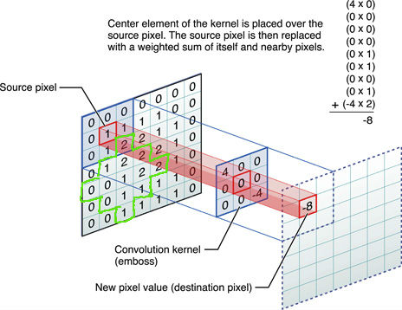
Convolutional Neural Network (CNN)
Mathematics Department University of Karachi
SYED UMAID AHMED

Slide 2
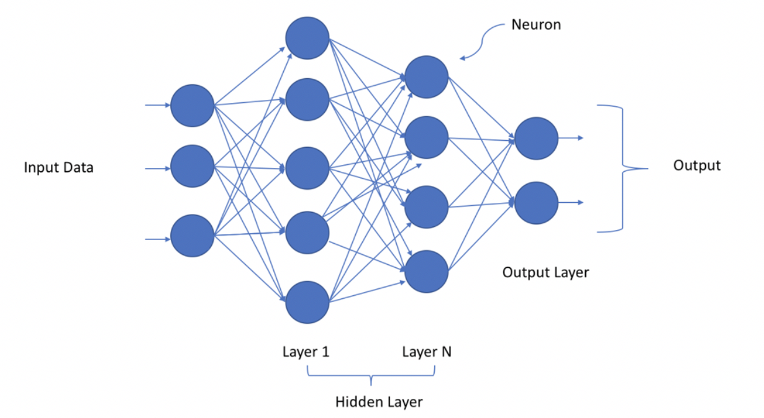

Slide 3
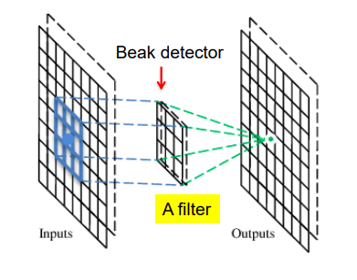
A CNN is a neural network with some convolutional layers (and some other layers).
A convolutional layer has a number of filters that does convolutional operation.

Slide 4
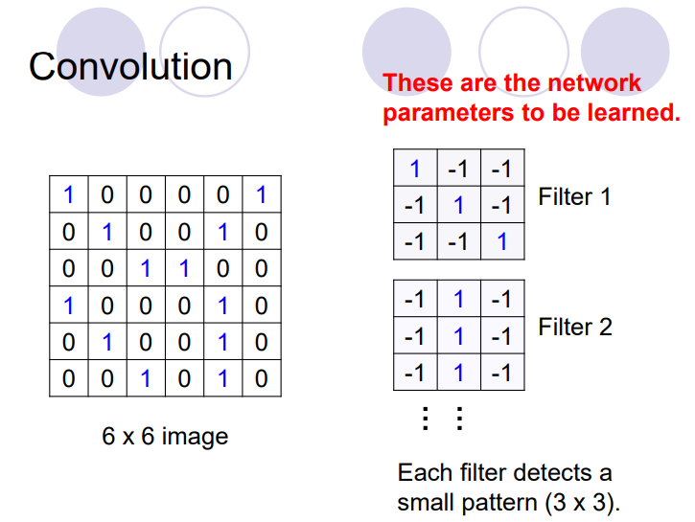

Slide 5
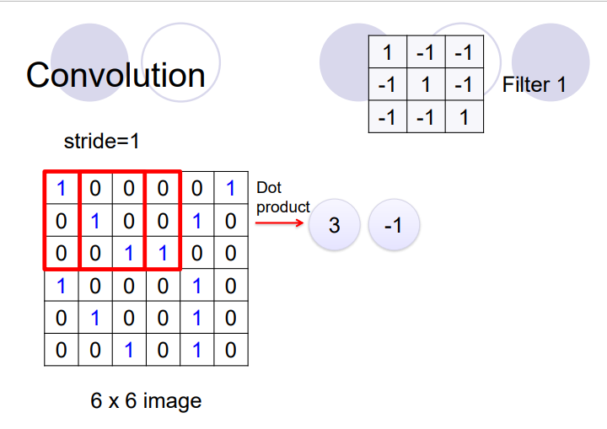
Lets Start the Manual Calculations by Hand …
Calculate All

Slide 6
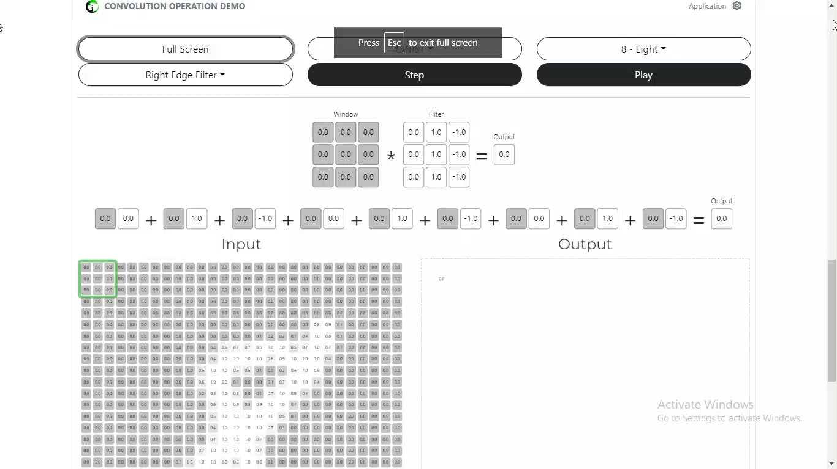

Slide 7
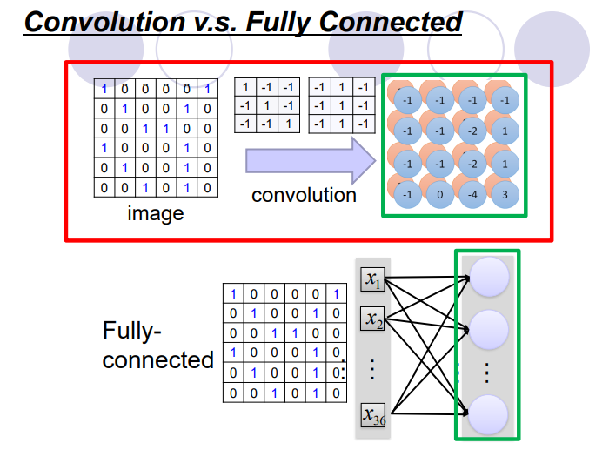

Slide 8
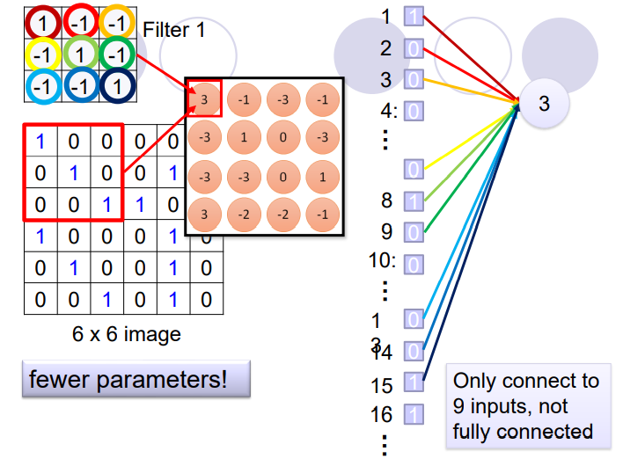

Slide 9
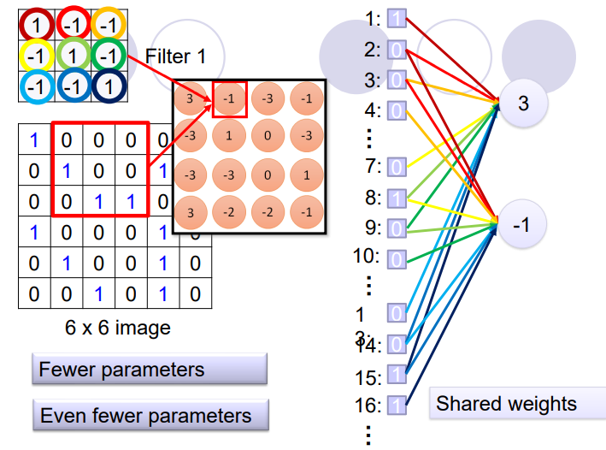

Slide 10
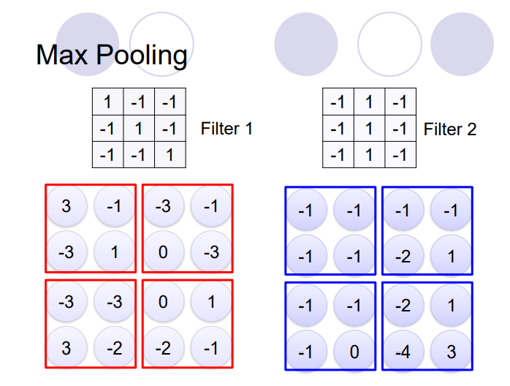

Slide 11
A CNN compresses a fully connected network in two ways:
⚫Reducing number of connections
⚫Shared weights on the edges
⚫Max pooling further reduces the complexity

Slide 12
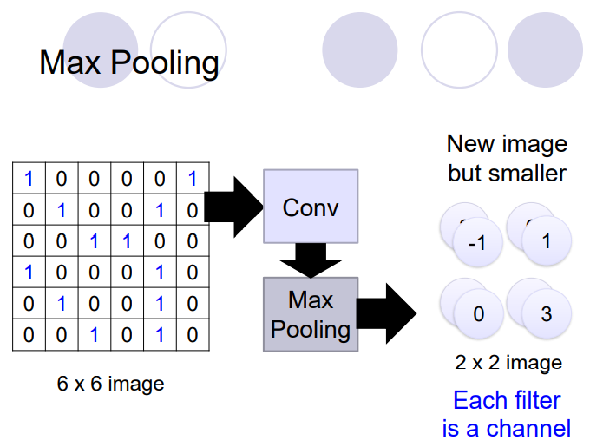

Slide 13
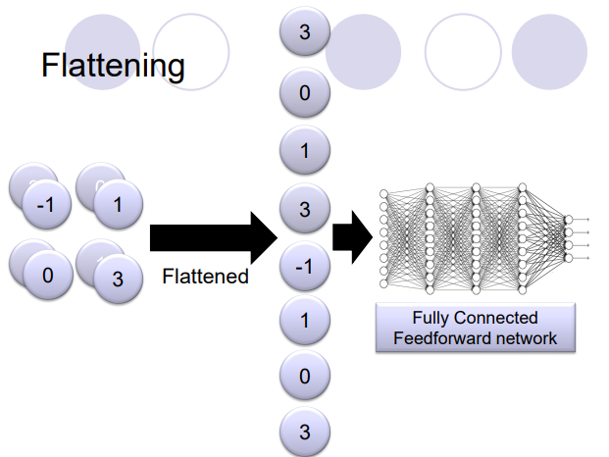

Slide 14
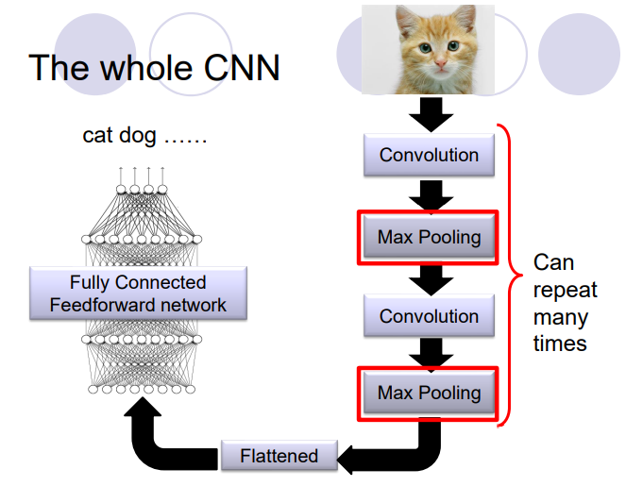

Slide 15
Read and Study in Detail
Back-Propagation in CNN
The medium article is attached with the GitHub Repository and can be downloaded as PDF
Jumping to the Python Keras
Implementation
https://github.com/SyedUmaidAhmed/Comvolutional-Neural-Network-Foundation-Lecture

